Slide 1

Captiva CEPD Beach Renourishment Vegetation Enhancements

Slide 2
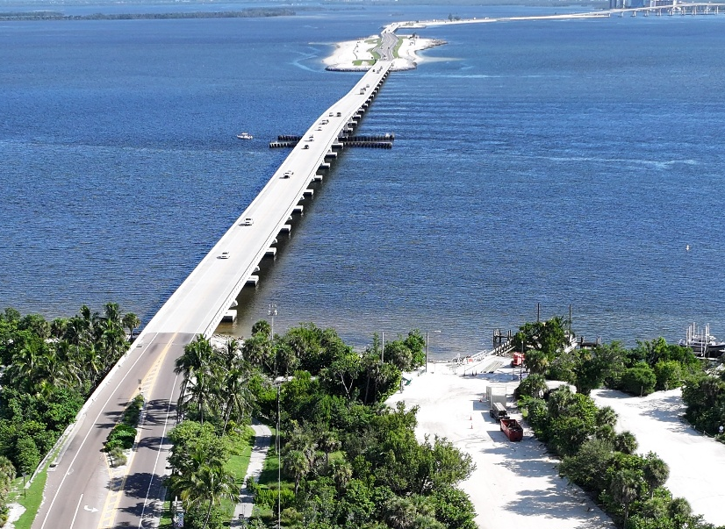
COASTAL VISTA DESIGN
LOCAL LANDSCAPE ARCHITECTURE & COASTAL
ADAPTATION STUDIO
PRACTICING ON SANIBEL AND CAPTIVA SINCE 2010
FOUNDED IN 2016
Leigh A. Gevelinger, PLA, ASLA, LEED AP
CVD FOUNDER
ASLA FLORIDA PRESIDENT
Rose Gilson, MLA
Landscape Architect Associate

Slide 3
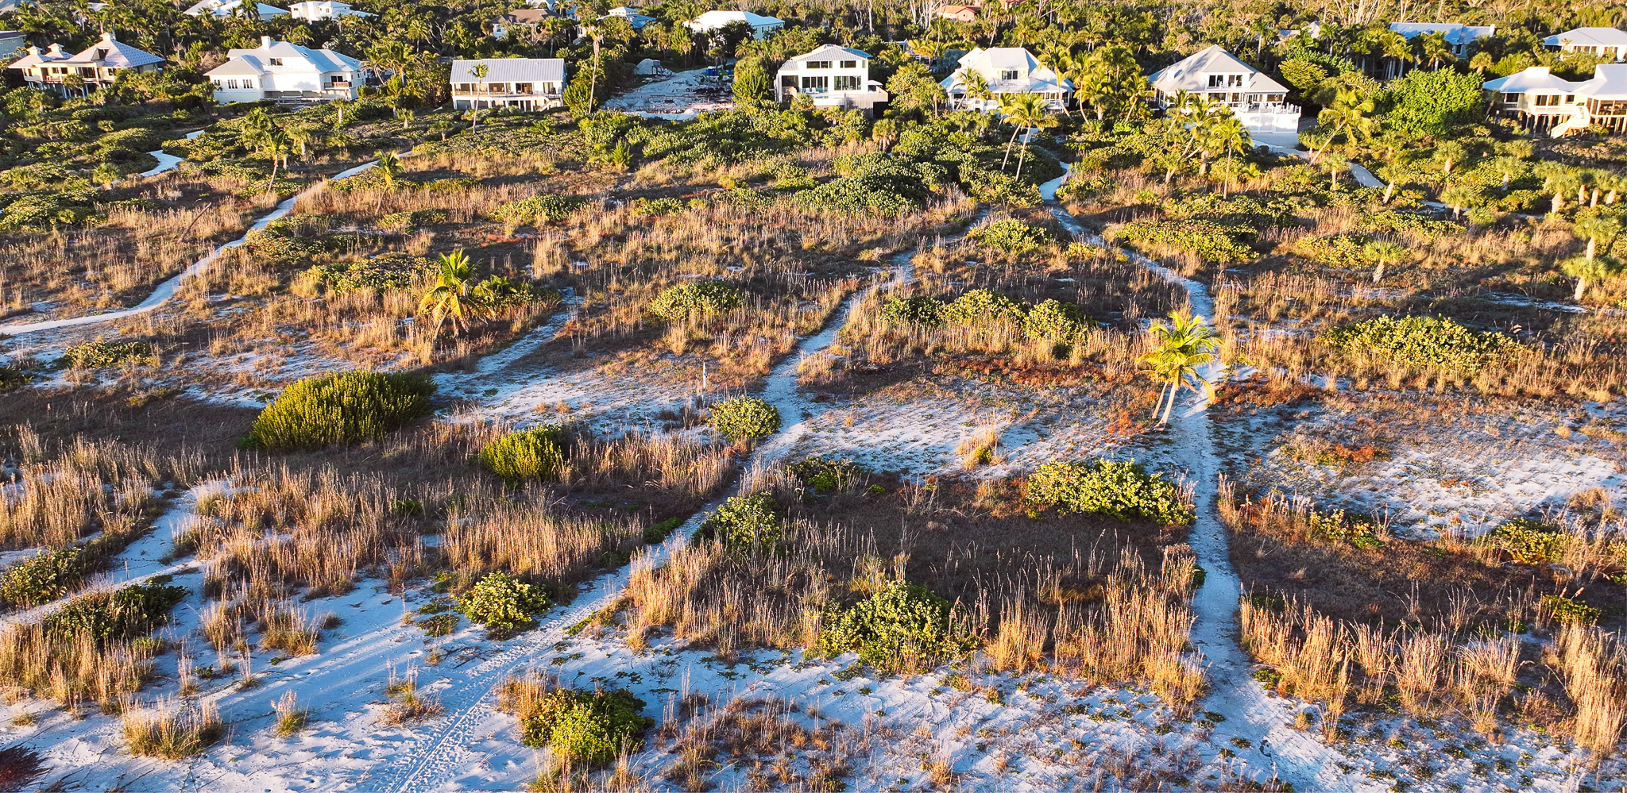
AGENDA
PROJECT EXTENTS
CONCEPT DESIGN
PLANTING APPROACH
ACTION ITEMS & NEXT STEPS
Q&A / DISCUSSION

Slide 4
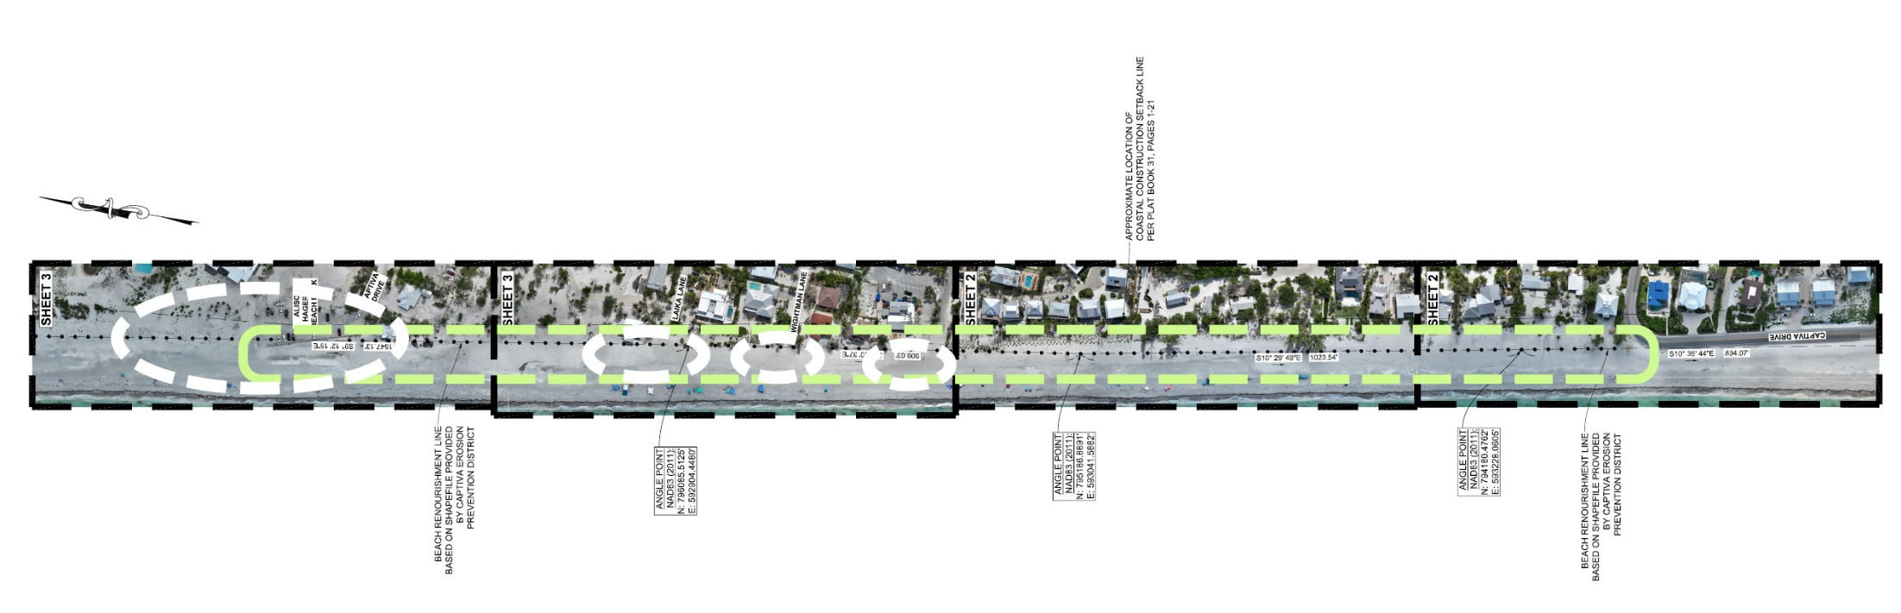

EXTENTS OF WORK – PUBLIC ACCESS POINTS

Slide 5
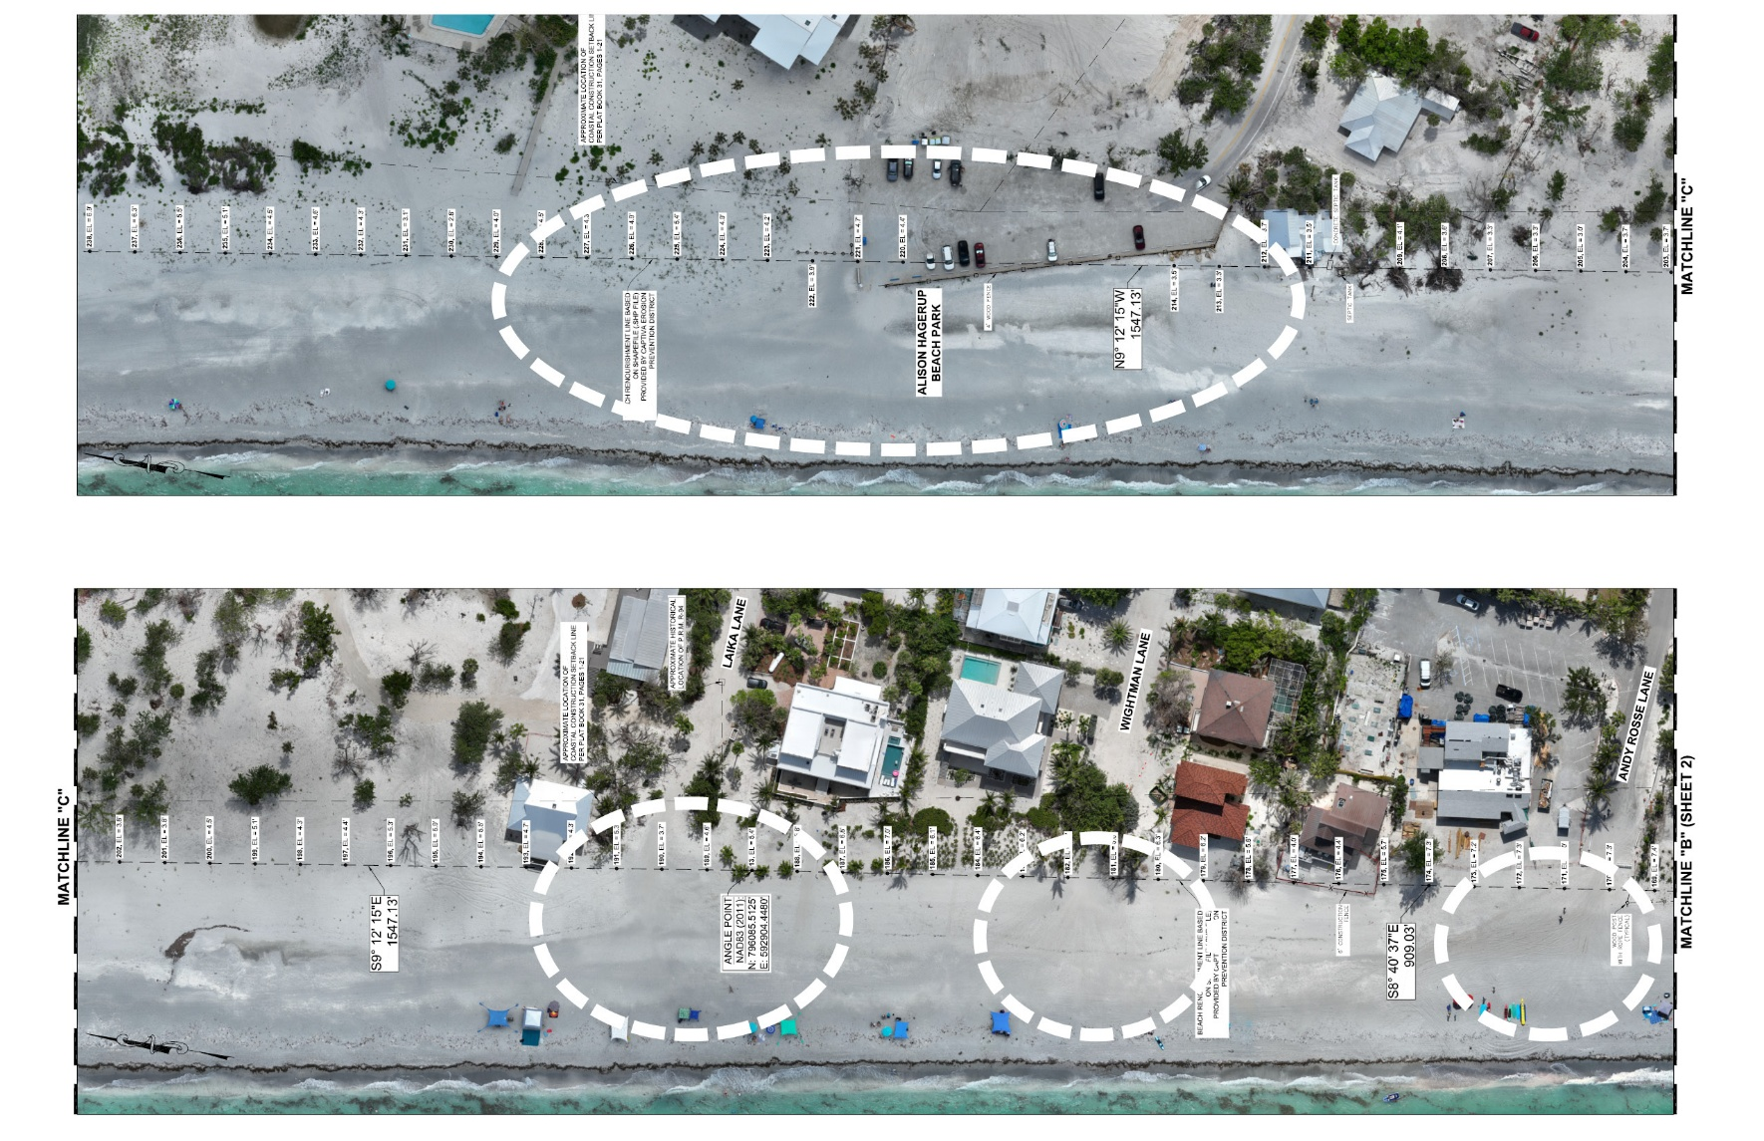
PUBLIC BEACH ACCESS FOCUS AREAS

Slide 6
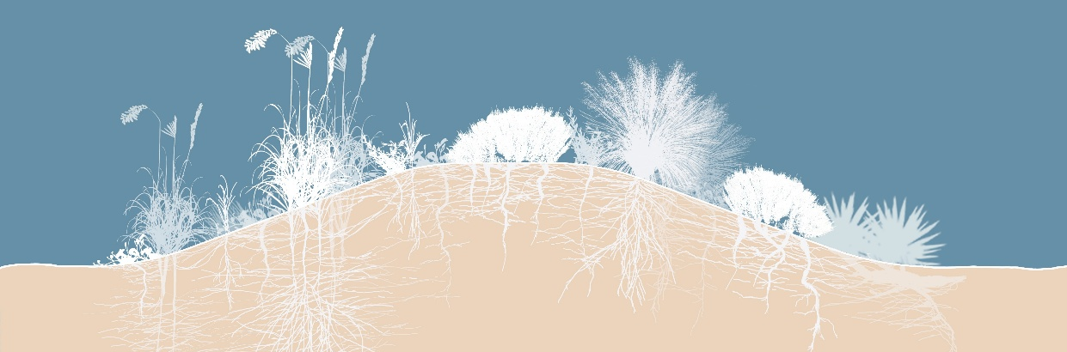
DUNES
DIVERSE STRUCTURES ABOVE + BELOW GROUND

Slide 7
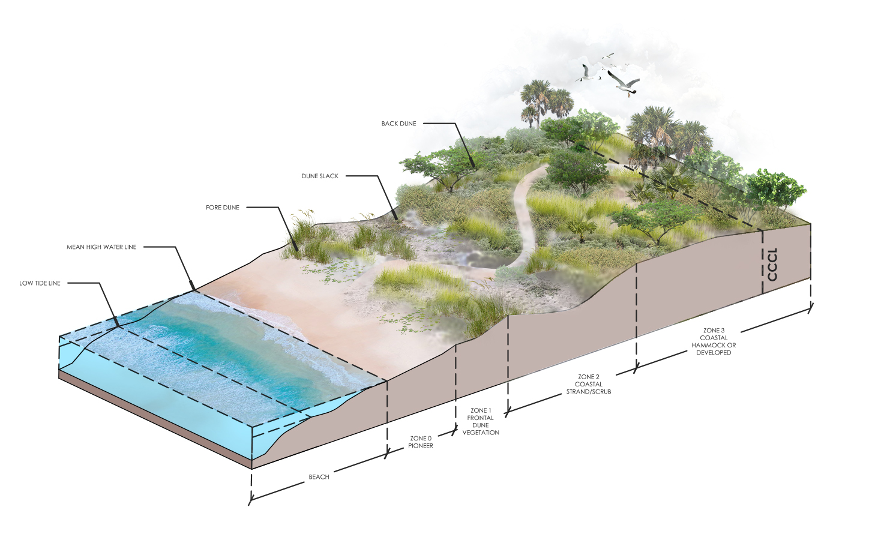
RESTORATION OF THE DUNE SYSTEM
RESTORATION FRAMEWORK

Slide 8
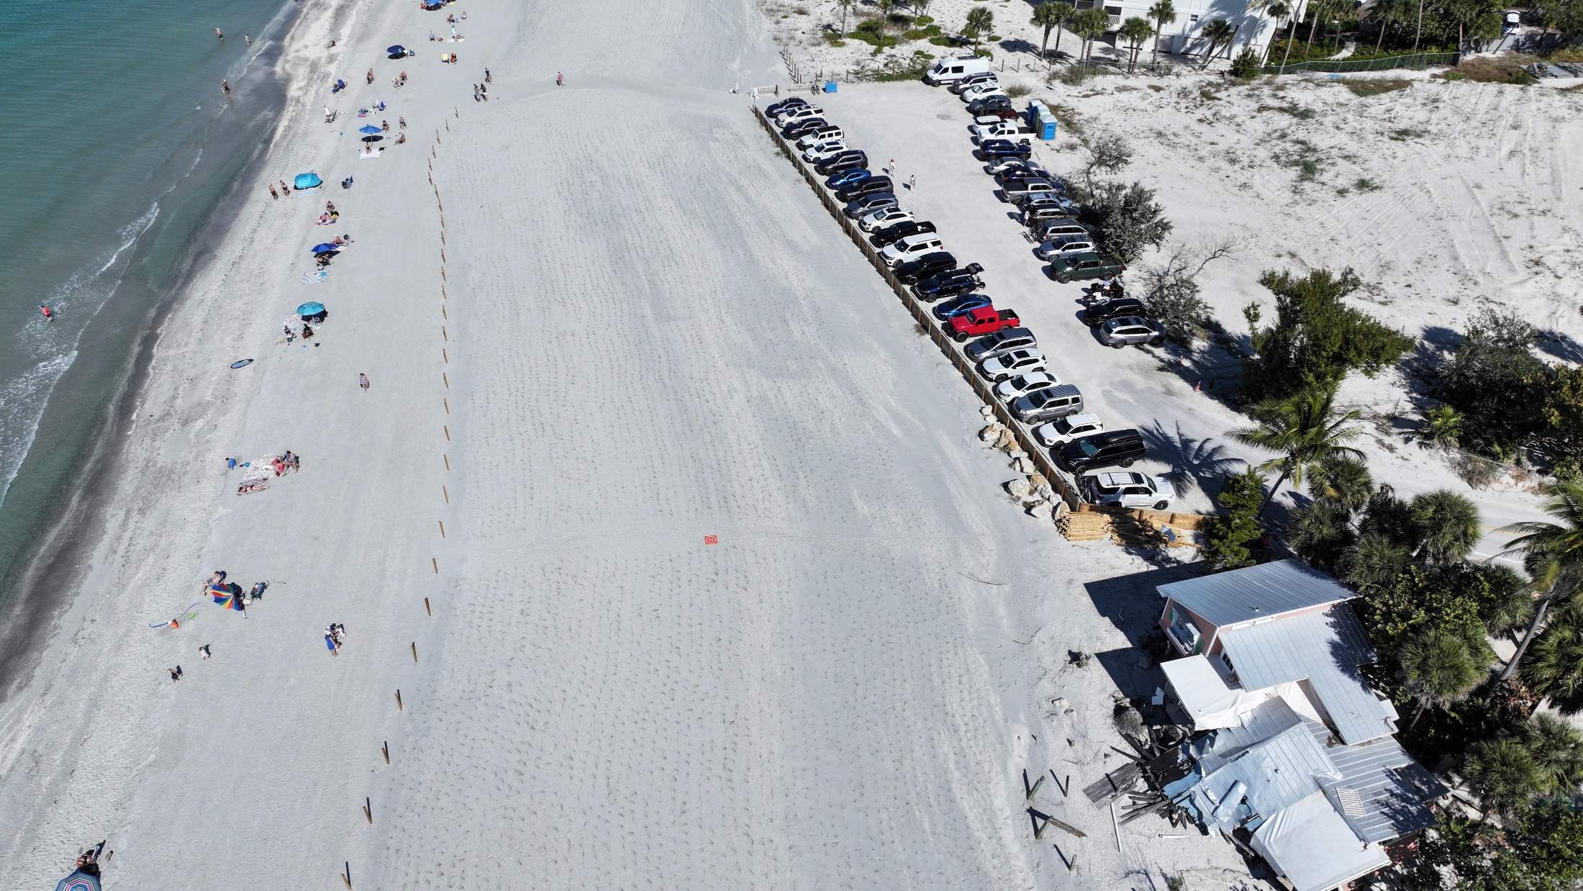
ALISON HANGERUP BEACH– JANUARY 2026

Slide 9
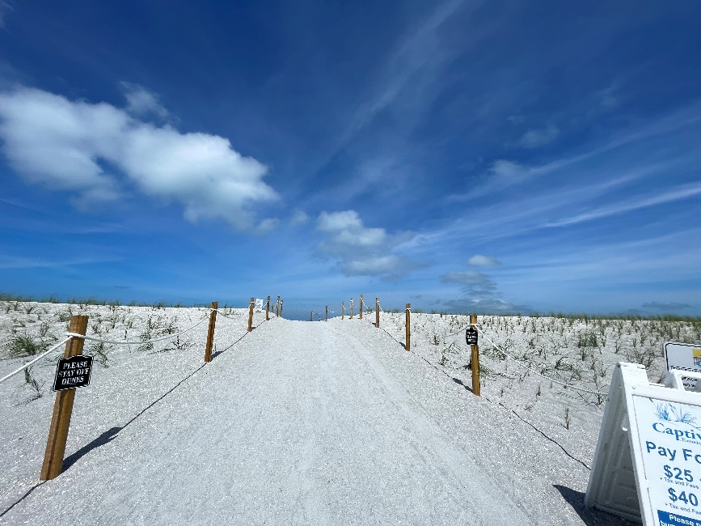
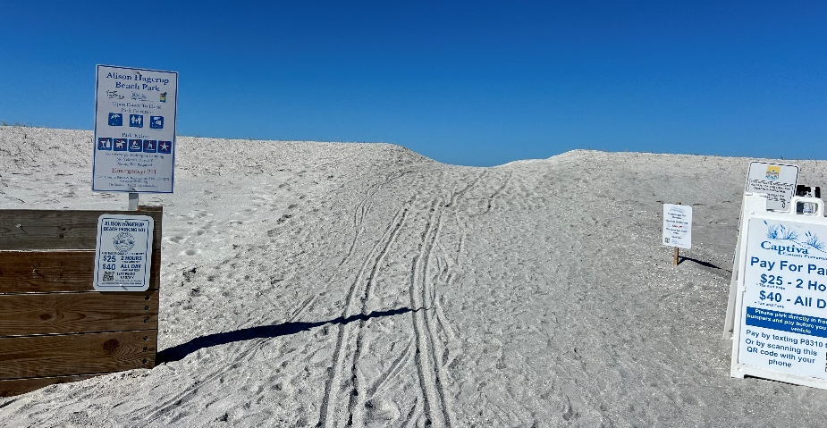
ALISON HANGERUP BEACH– JANUARY VS. MAY 2026

Slide 10
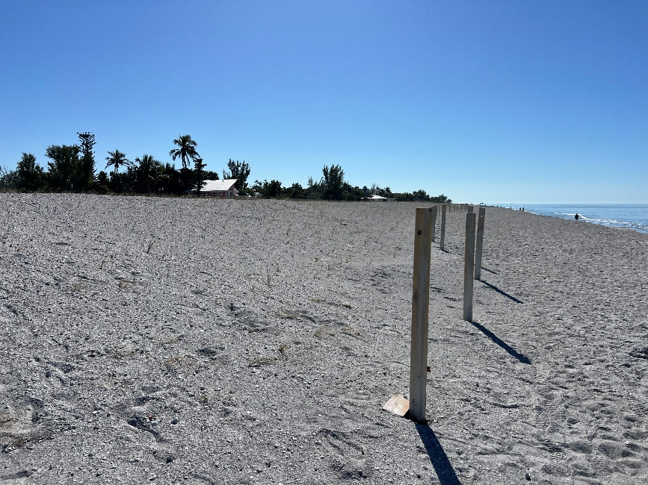
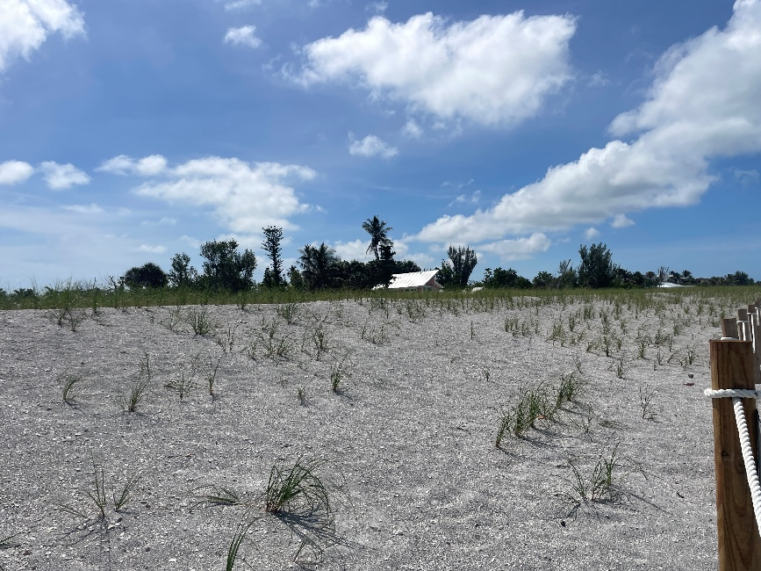
ALISON HANGERUP BEACH– JANUARY vs. MAY 2026

Slide 11
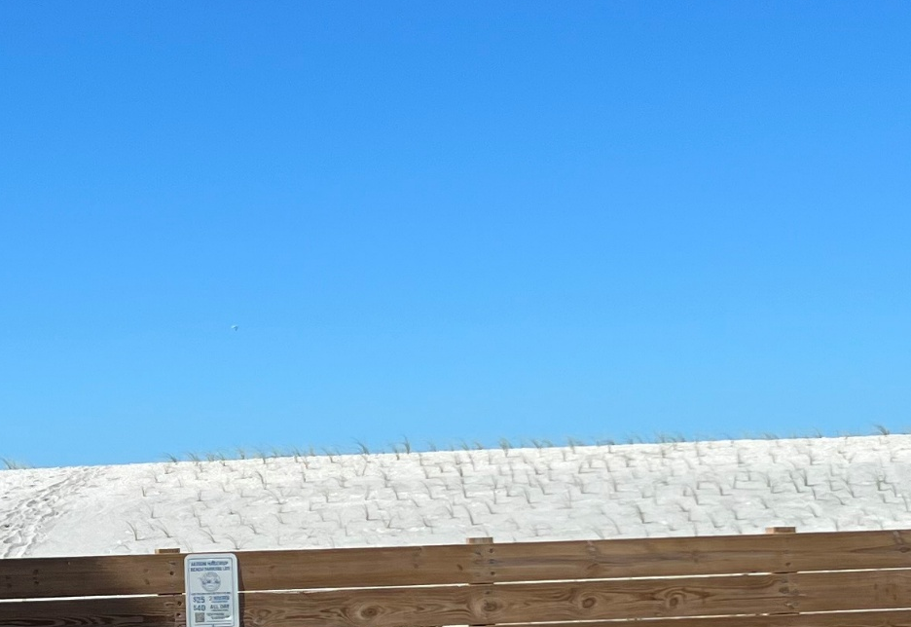
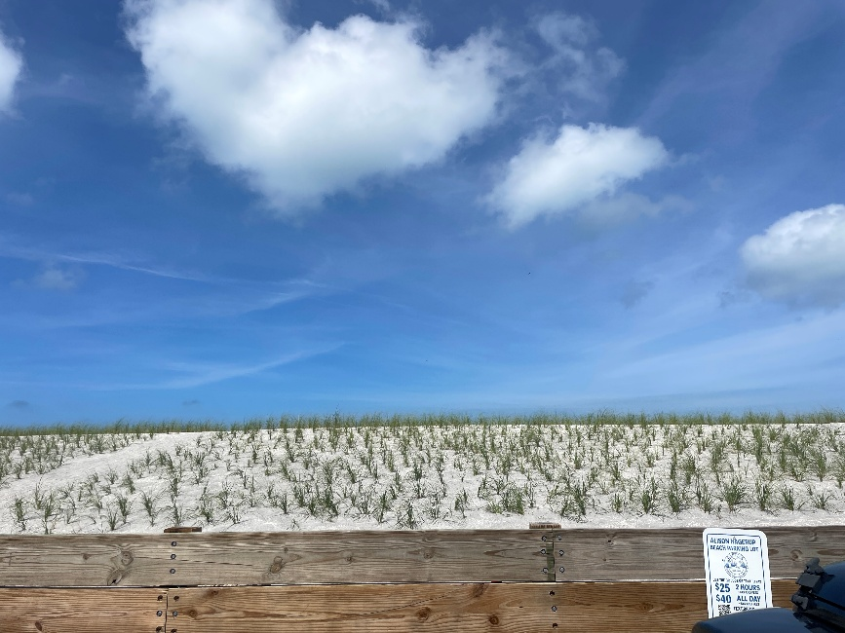
ALISON HANGERUP BEACH– JANUARY vs. MAY 2026

Slide 12
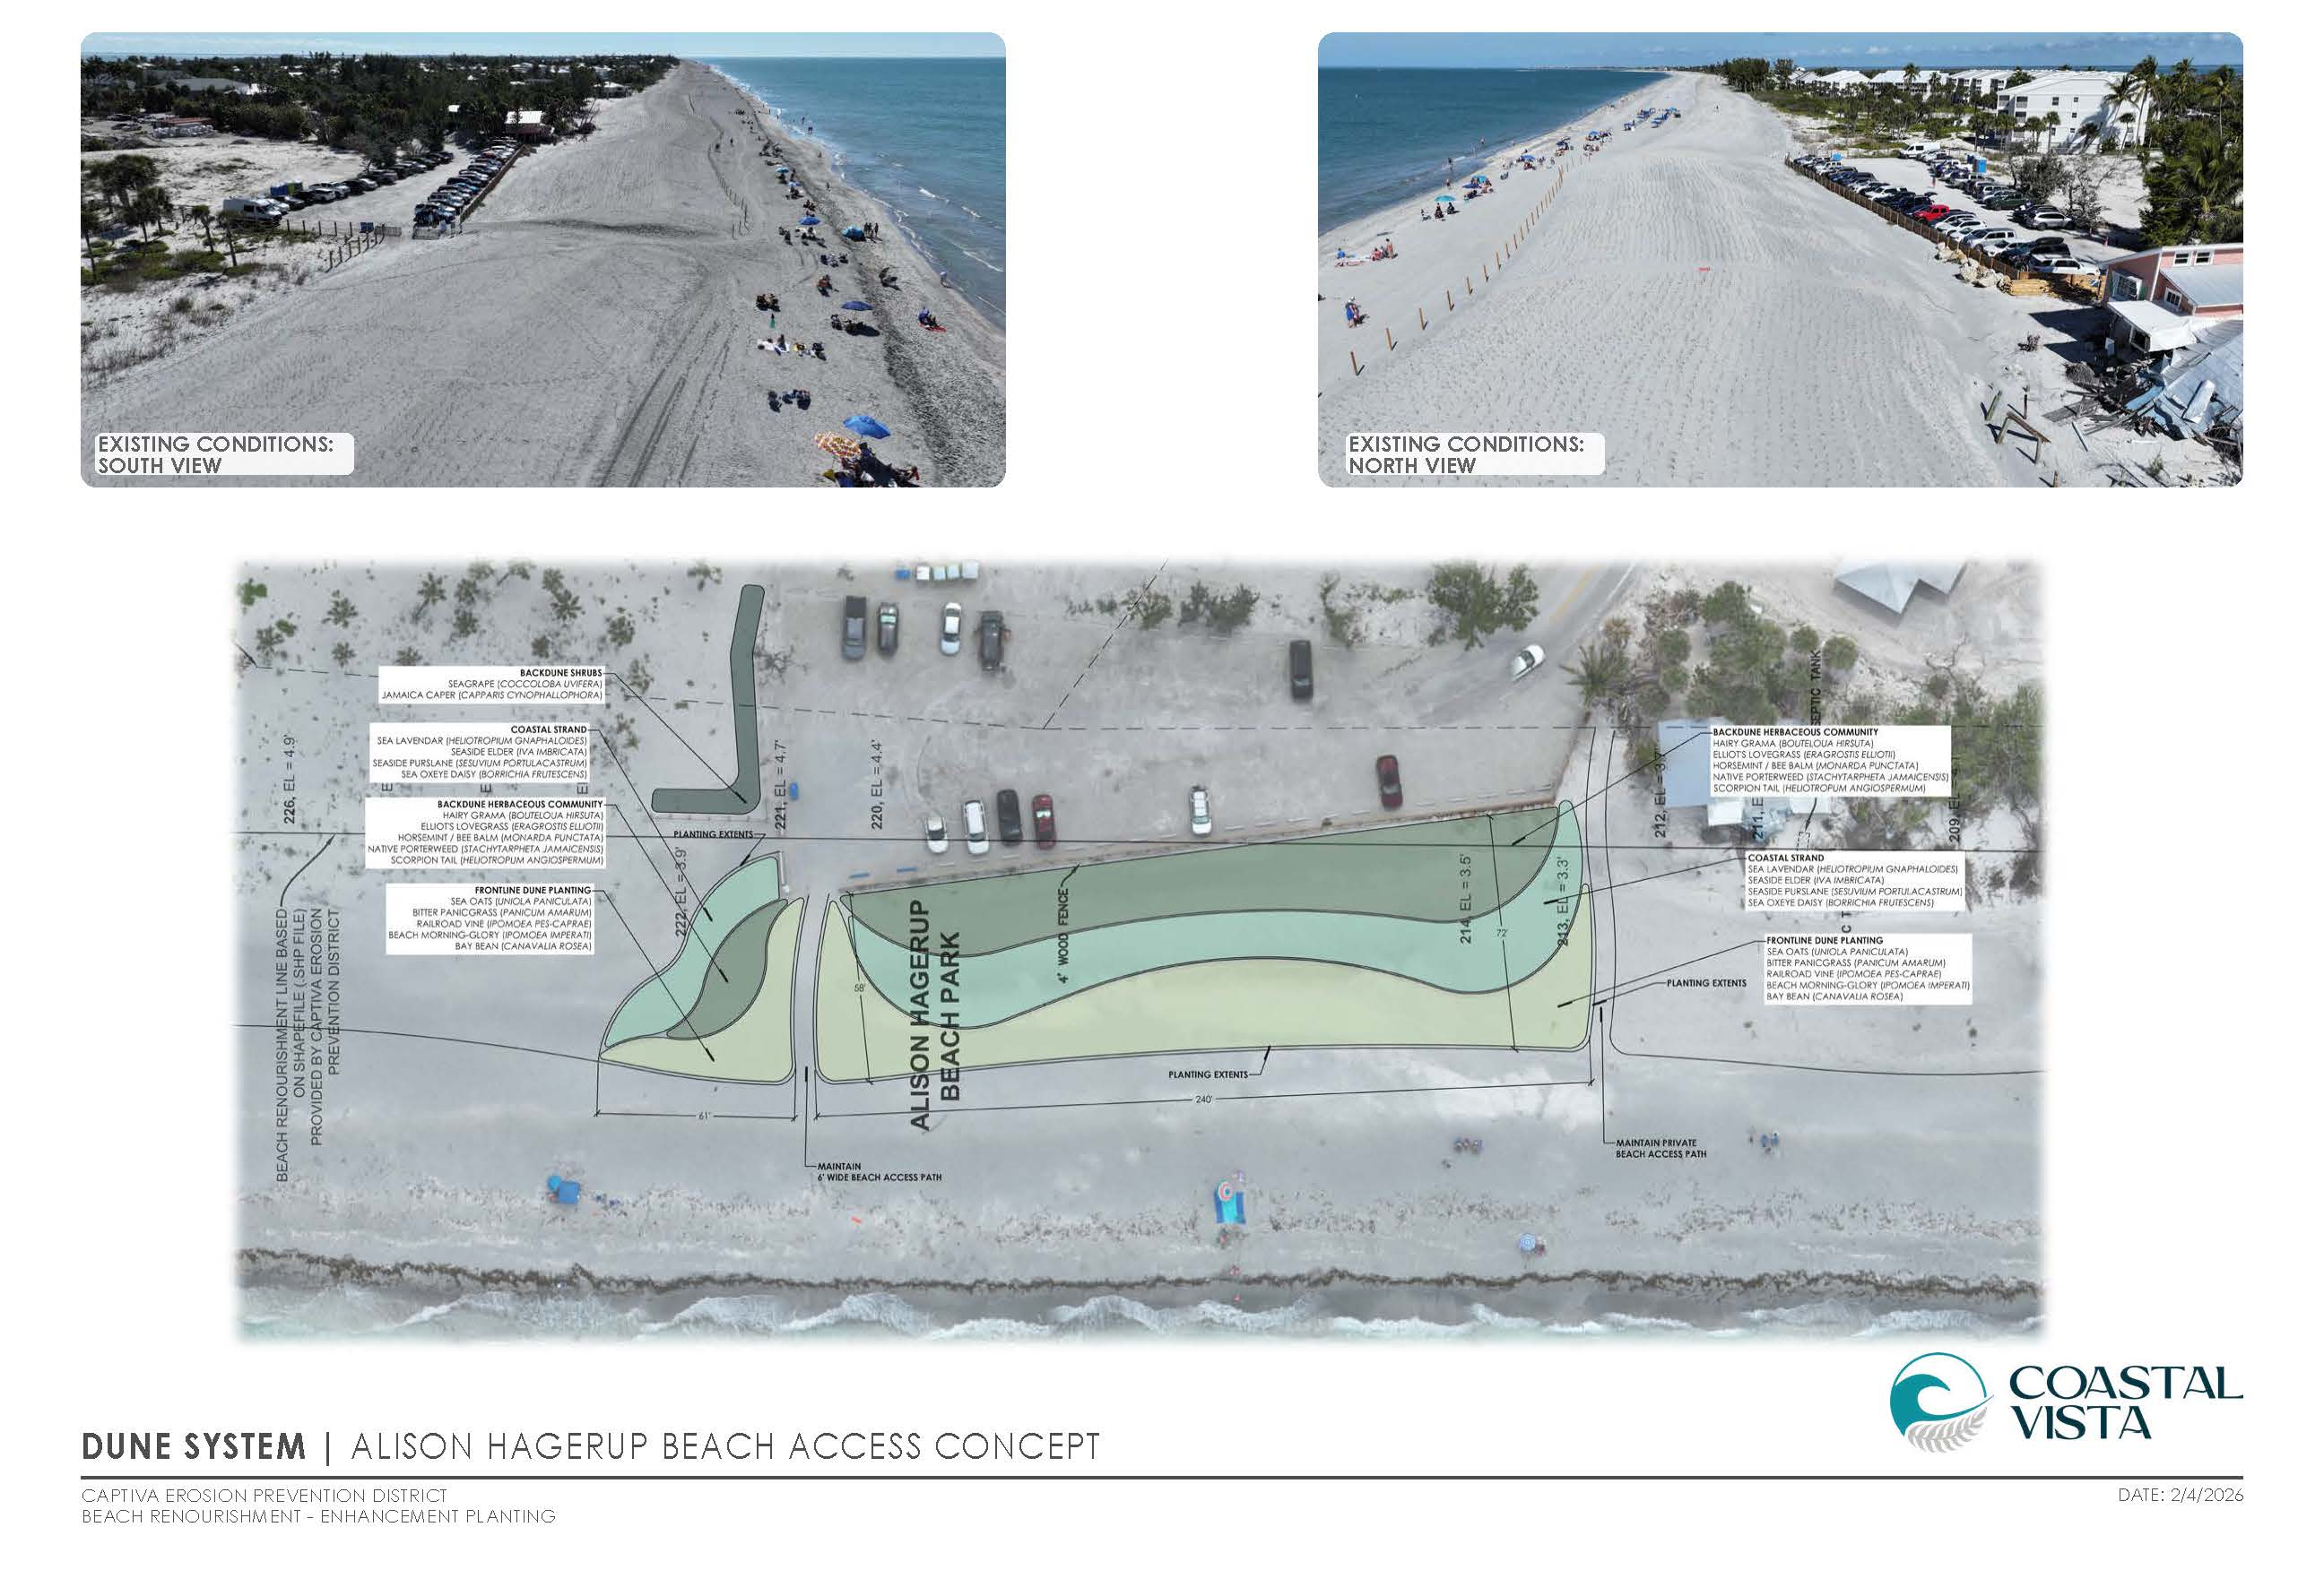

Slide 13
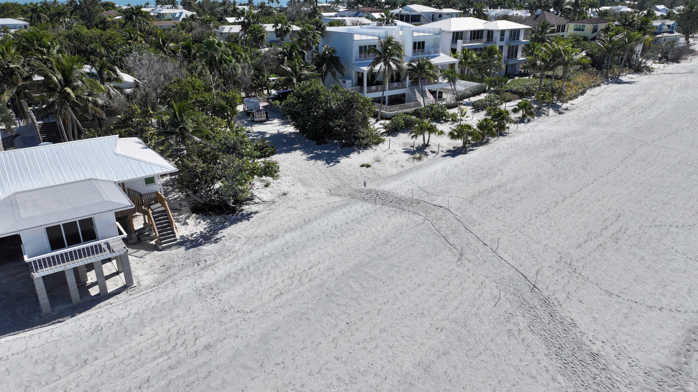
LAIKA LANE– JANUARY 2026

Slide 14
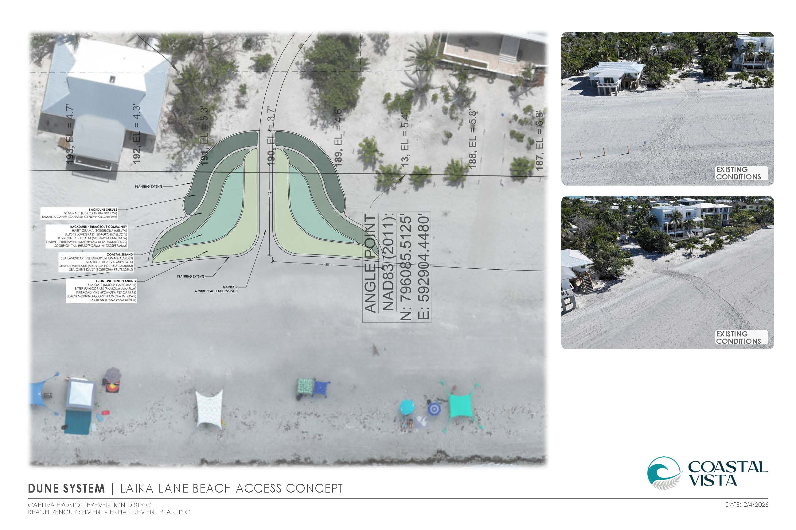

Slide 15
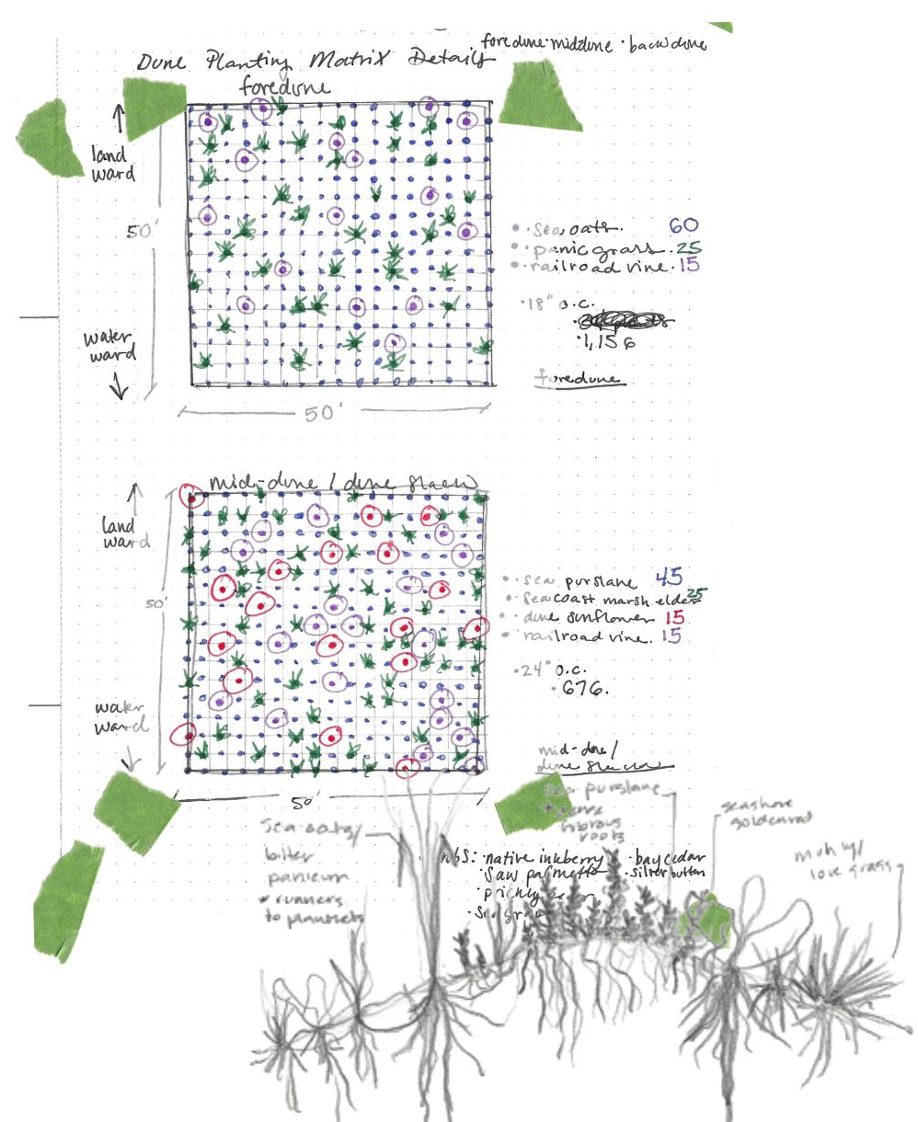
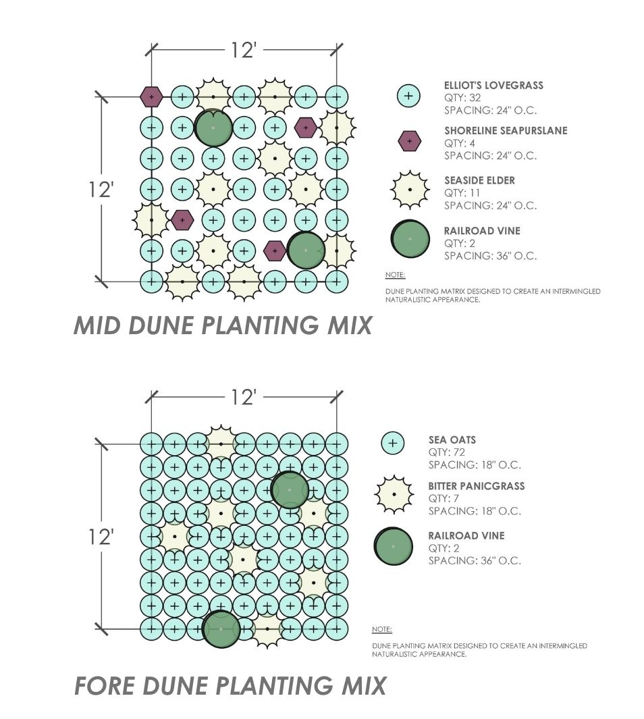
MATRIX
RESTORATION FRAMEWORK

Slide 16
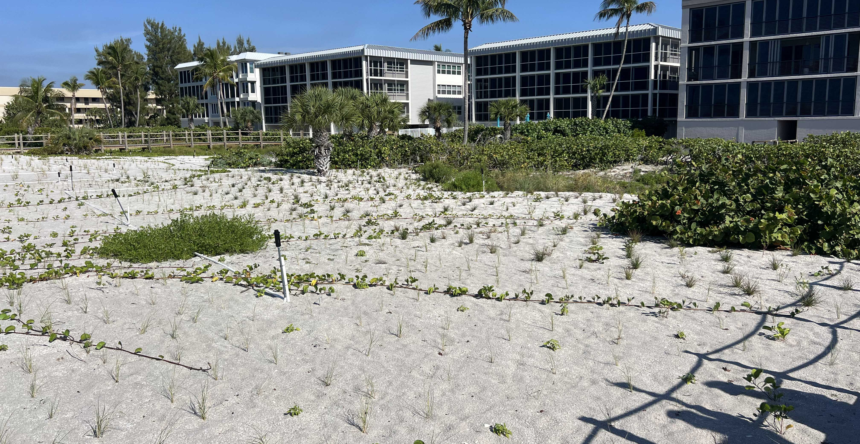
DUNE PLANTING MATRIX– FEBRUARY 2026

Slide 17
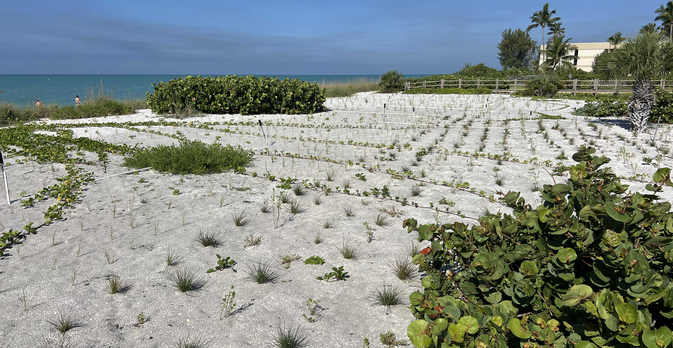
DUNE PLANTING MATRIX – FEBRUARY 2026

Slide 18
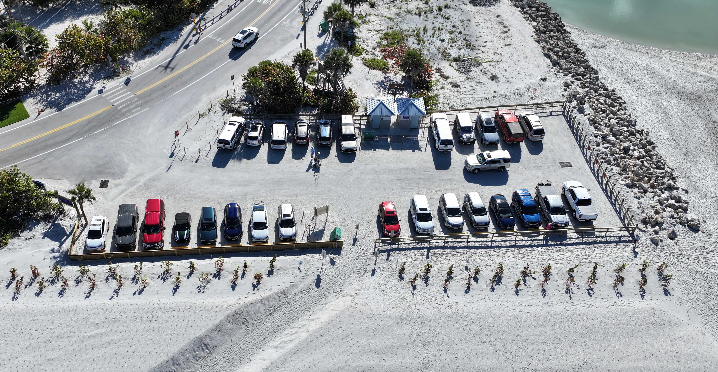
BACK DUNE PLANTING FORTIFICATION

Slide 19
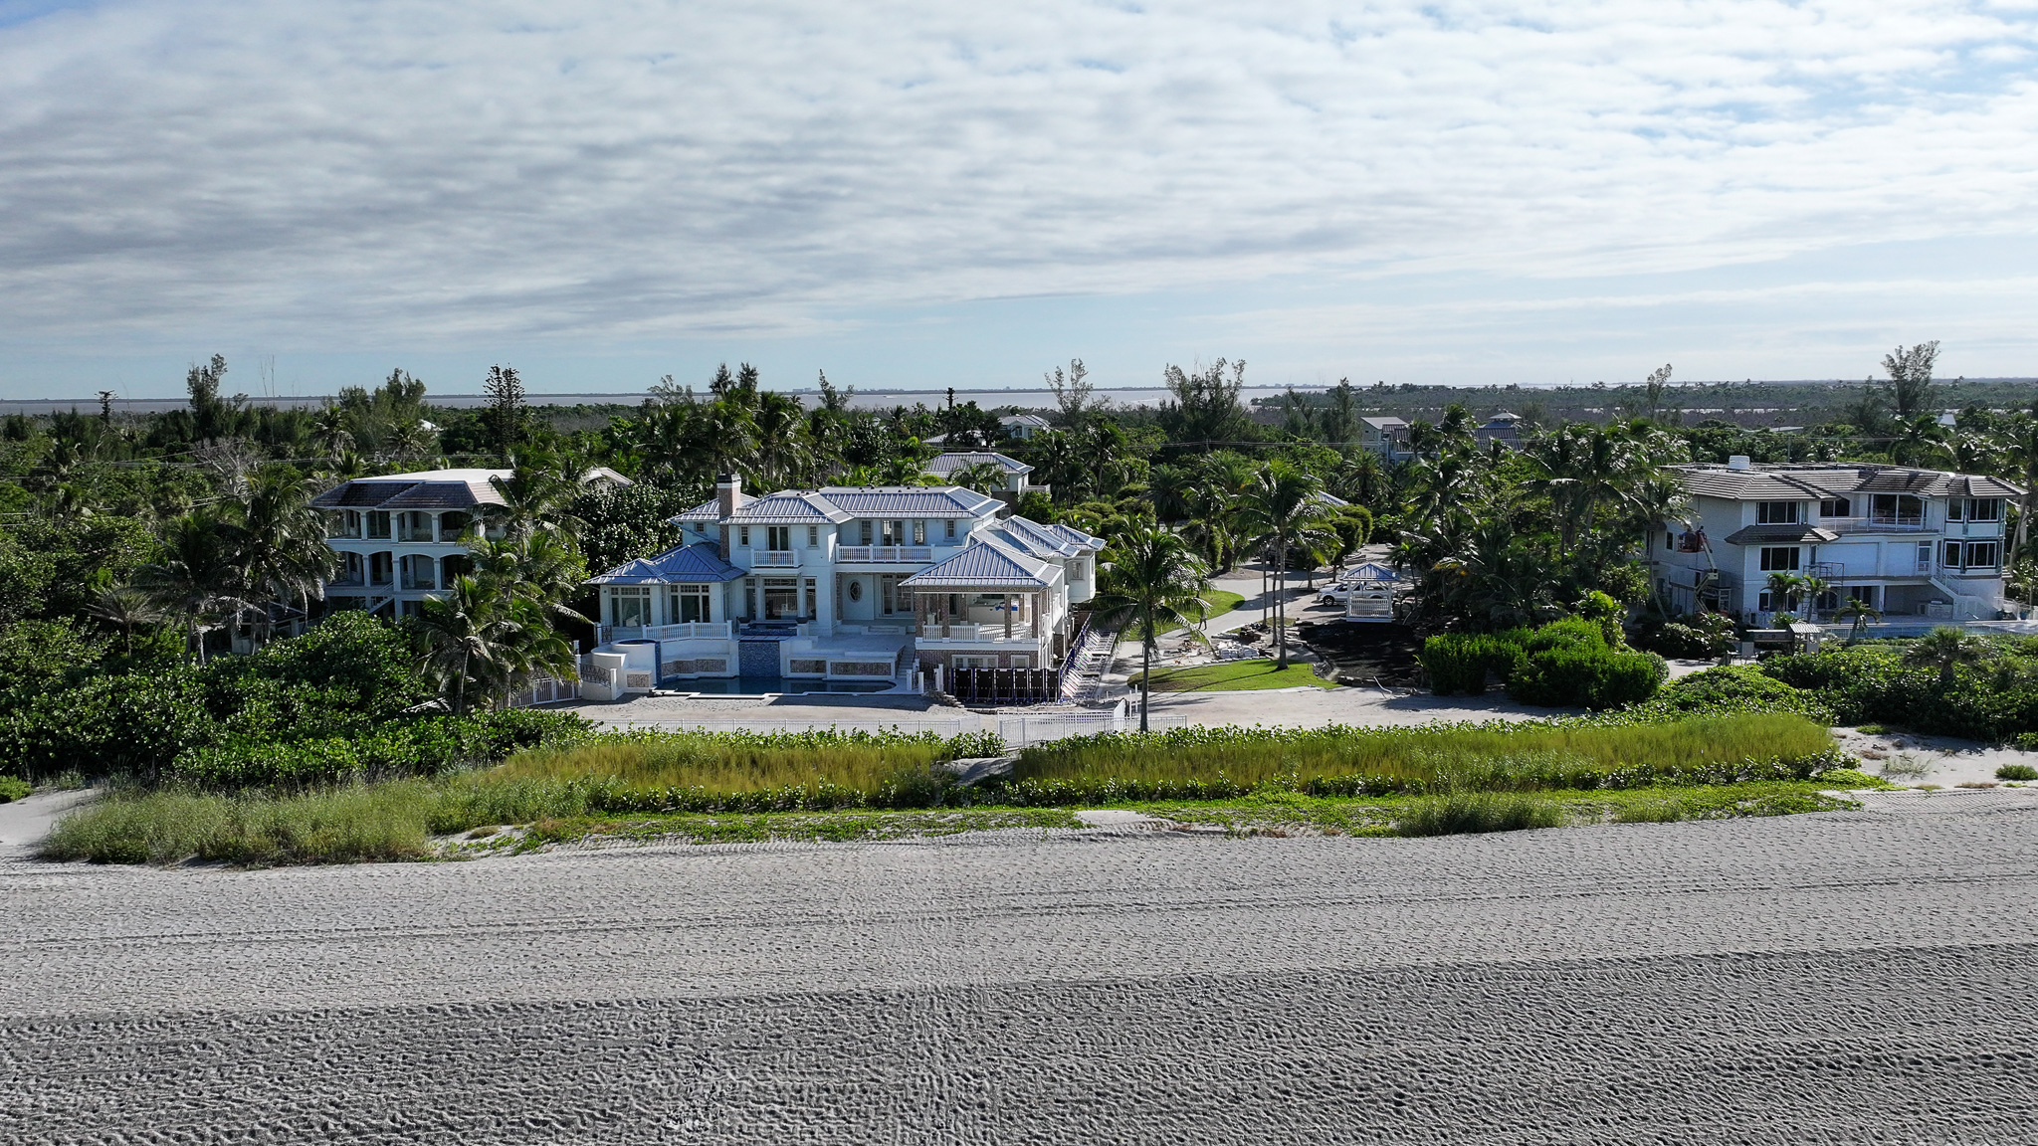

Slide 20
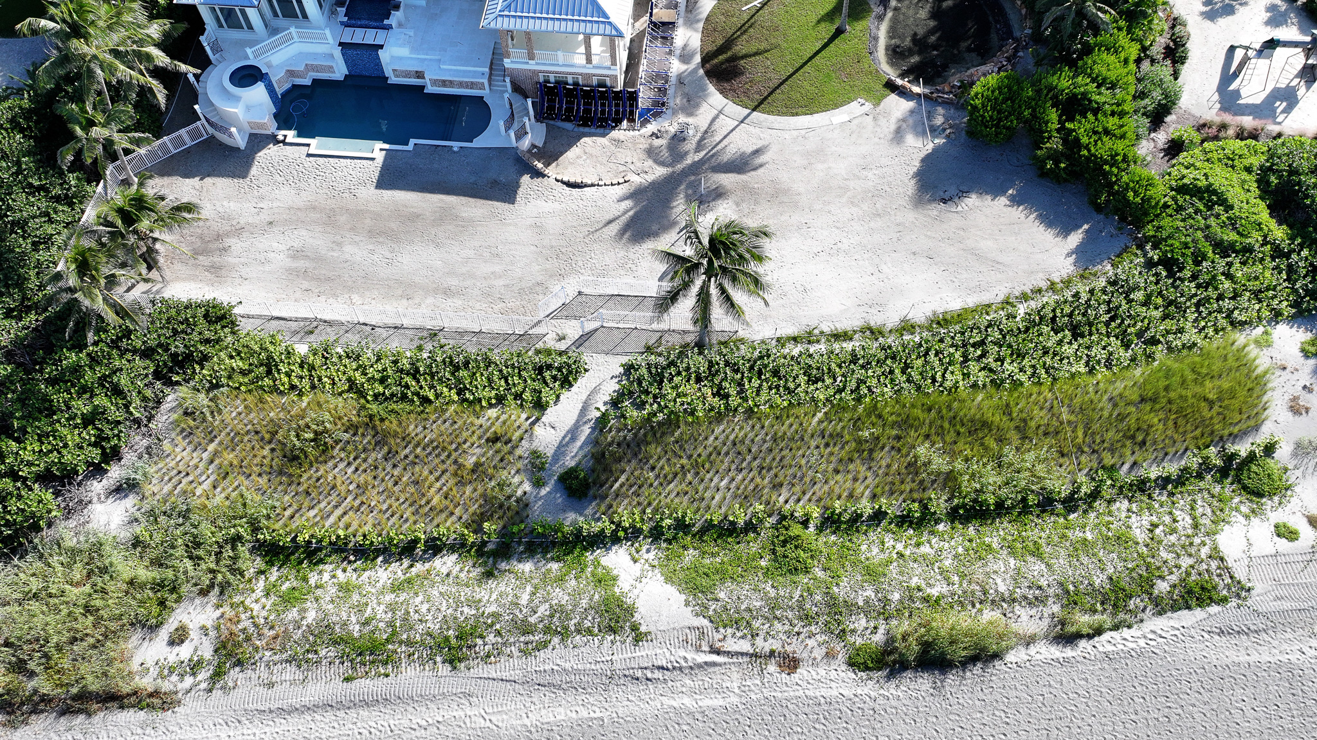

Slide 21
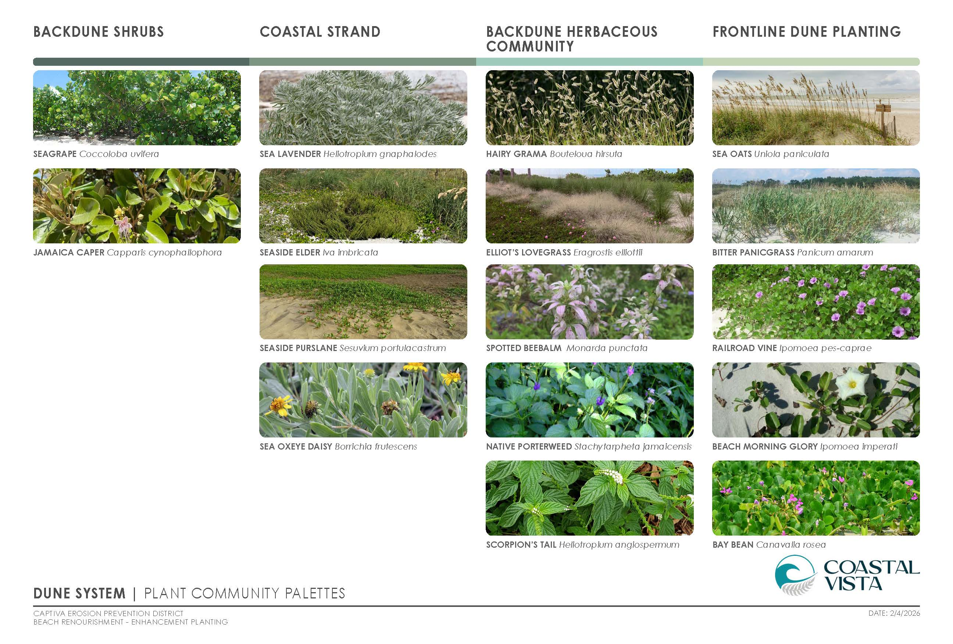

Slide 22
DISCUSSION

